Slide 1

Can Paying Attention to Oral Health
Reduce Medical Care Costs?
“Oral Health is Integral to Overall Health”
“Oral infections have an impact
on systemic diseases”
Gary L. Dougan, DDS, MPH
National Dental Director

Slide 2

When Did the Mouth Separate from the Body?
Dentistry Medicine

Slide 3
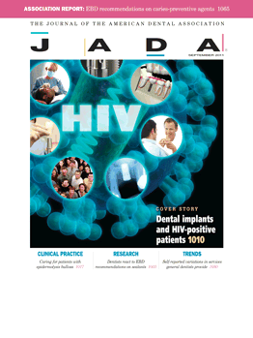

Disease Management
Dental Disease Management is a rapidly growing industry with more than $2 Billion in annual spending. Federal and State government officials, as well as some of the Nation’s largest health plans are now requiring that Dental Disease Management programs be considered as standard with regard to quality assurance services.
According to the Journal of the American Dental Association (JADA):
“Participants with rheumatoid arthritis, diabetes or a liver condition were twice as likely to have an urgent need for dental treatment as were participants who did not have these diseases. After controlling for common risk factors, the authors found that arthritis, cardiovascular disease, diabetes, emphysema, hepatitis C virus, obesity and stroke still were associated with dental disease.”
LIBERTY Dental Plan is prepared and at the forefront of the efforts to improve patient outcomes by combining Dental Disease Management with similar existing accepted and recognized Medical programs.

Slide 4






Dental Disease Management Program
LIBERTY is the only dental plan that is a member of the Care Continuum Alliance (formerly, Disease Management Association of America). Our DDMP is rooted on the correlation between good dental health and its impact on the individual overall health; e.g., improving the clinical outcomes of members suffering from chronic illnesses, such as diabetes and cardiovascular disease. Our DDMP links periodontal care and dental case management with medical case management to improve clinical outcomes and positive impact on HEDIS measures directly related to those conditions.
LIBERTY joins these companies and others as a member of the Care Continuum Alliance:

Slide 5
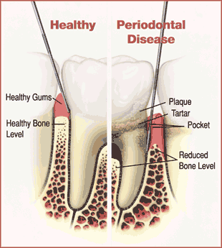
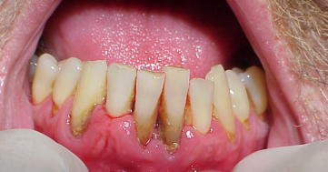
Periodontal Disease
Periodontal disease is a chronic bacterial infection that affects the gums and bone supporting the teeth
Most significant dental disease affecting adults
Affects 3 out of 4 persons at some point in their life
75+% of adults over 35 have significant periodontal disease
Severity increases with age
Profound Links with systemic diseases
Key to Health Plan Cost Savings is control of periodontal disease

Slide 6




.
Osteoporosis
Heart Disease
Stroke
Pregnancy
Diabetes
Others Possible Links Being Investigated
COPD? Alzheimers Disease? Kidney Disease?

Slide 7
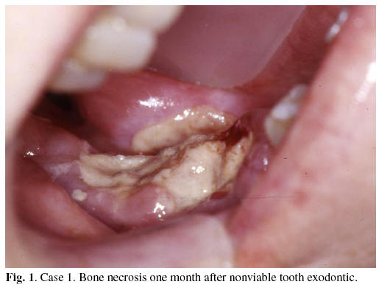

Osteoporosis
Oral Bisphosphonate therapy
(Fosamax, Actonel, Boniva)
Osteonecrosis of the Jaw
Early detection through dental x-rays
More aggressive bone loss from periodontal disease
Opportunity: Health Plans can significantly reduce health care costs of osteonecrosis with better oral health integration

Slide 8
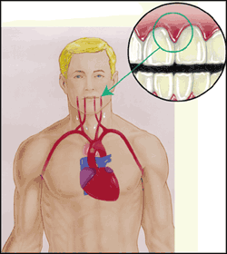
Cardiovascular Disease (CVD)
Heart Disease and Stroke: #1 and #3 leading causes of death in America
>$503 Billion: Health care cost directly associated with CVD
81 million adults with CVD
~ 1 million Americans die each year
25-50% of CVD patients and cerebrovascular accident patients have no traditional risk factors
1.5 to 4 fold increased risk for heart disease in people with periodontal disease
85% of heart attack patients studied had periodontal disease compared to 29% of people with no heart problems
Opportunity: Health Plans can significantly reduce health care costs of CVD with comparative low cost periodontal therapy

Slide 9
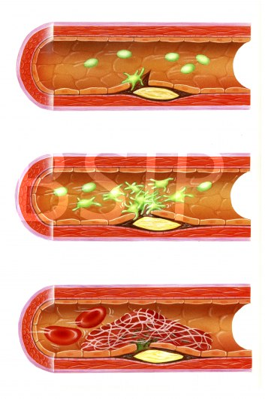
CVD and Periodontal Disease
Atheroma: A deposit of lipid-containing material in arterial walls
55% of Atheromas examined contained P. Gingivalis or
S. Sanquinis (periodontal pathogens)
C-Reactive Protein (a risk factor for CVD) is increased in periodontal disease and reduced with perio therapy

Slide 10
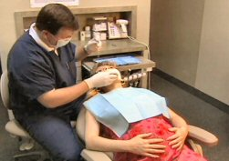
Pregnancy and Periodontal Disease
1990’s: Study found a 7X increase in Premature Low Birth Weight (PLBW) babies in women with periodontal disease
Annual health care cost of $26.2 billion
Treatment of periodontal disease during pregnancy associated with reduced risk of PLBW
84% reduction of premature births in women who received scaling and root planing during pregnancy [Jeffcoat et al;2003]
Opportunity: Health Plans can significantly reduce health care costs with even one PLBW case prevented

Slide 11
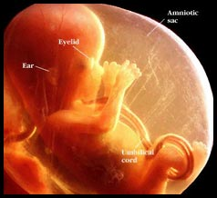
2010: First Fetal Death Related to Periodontal Disease
Systemic Inflammatory Response
Prostaglandin E2 (PGE2) release triggers preterm labor and associated PLBW
Significantly higher PGE2 levels in mothers with periodontal disease

Slide 12
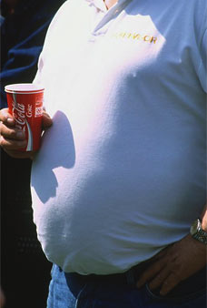
Diabetes
#6 leading cause of death in America
7.8% of the population have diabetes
23.6 million people affected
  17.9 million diagnosed
  5.7 million undiagnosed
57 million pre-diabetic
Periodontal disease is considered the sixth complication of diabetes
Those with periodontal disease have 2 X the prevalence of diabetes as those without periodontal disease
Opportunity: Significant Health Plan Cost Savings possible with control of periodontal disease

Slide 13
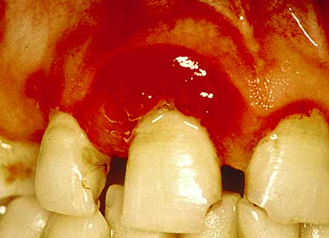
Two-Way Linkage Between Diabetes and Oral Disease
Diabetes predisposes to oral infection and once established the oral infection exacerbates diabetes
Greater prevalence, incidence, and severity of periodontal disease found in diabetics
Severe periodontal disease found to increase the severity of diabetes

Slide 14
Why Does Diabetes Continue to Command Our Attention?
  Because EVERY 24 Hours there are:
    * 4,100 New Cases of Diabetes
    * 810 Deaths Due to Diabetes
    * 230 Amputations
    * 120 Kidney Failures
    * 55 New Cases of Blindness
Source: NIDDK, National Diabetes Statistics fact sheet. HHS, NIH, 2005.

Slide 15

Estimated Cost of Diabetes in the United States
* Direct Medical Cost: $116 billion
* Indirect Cost: $58 billion
* Total Cost: $174 billion
Approximately $1 in $10 health care dollars (10% of all health care spending) may be attributed to diabetes.
Source: CDC 2007

Slide 16
Health Plan Implications for Cost and Outcomes
Resolution of periodontal infection appears to improve glycemic control in Type 2 diabetics
Periodontal Disease control may also be shown to reduce diabetic complications
Management of Periodontal Disease is becoming an important component of treatment of diabetes
Someday, periodontal therapy may be considered “Medically necessary dental therapy” for diabetics (with coverage provided by or coordinated by the health plan
Conversely, diabetics being treated at a dental office may have their periodontal therapy considered as “medically necessary.”

Slide 17
Diabetes and Dental Intervention
Intervention by Treating Dentist
  Patient Education
  Scaling and root planing
  Antibiotic therapy
  Periodontal Maintenance therapy
Outreach by LIBERTY Dental Plan
Contact Priority
All members who have not utilized at all
All members who have not had Perio treatment
All members who have not had Prophy treatment
Result
  Periodontal therapy improves glycemic control
  Improved HBA1c levels
  Improved periodontal health
  Improved overall health status and quality of life

Slide 18
Medical – Dental Integration
Association between periodontal disease and systemic disease has been demonstrated in:
  Human retrospective studies
  Interventional studies
  Case-control studies
  Micro-biological studies
  Animal studies
  This is clear evidence of the linkage and mutual benefit derived when medical health plans and LIBERTY dental plan works together to improve the oral health, overall health and quality of life of our mutual members

Slide 19

Disease Management in the Dental Benefits Industry
Diabetes:
Blue Cross Blue Shield of Massachusetts claims data shows that members receiving Dental Prophylaxis and/or Periodontal Treatment had $144 PMPM lower medical costs than members that did not seek these treatments.
Coronary Artery Disease:
The same data shows that members suffering from Coronary Artery Disease (CAD) who received Dental Prophylaxis and/or Periodontal Treatment had $238 PMPM lower medical costs than members that did not seek these treatments.
“About 3 times as many patients with diabetes (46.9% versus 16.0%) who were successfully contacted had both a chronic care visit… compared to patients who were not contacted via outreach.”
According to a recent study published in ‘Population Health Management’ (The official journal of the Care Continuum Alliance)

Slide 20
Disease Management in the Dental Benefits Industry
  2003 claims data showed that members that received Dental Prophylaxis and/or Periodontal Treatment had $144 PMPM lower medical costs than members that did not seek these treatments.
  2008 claims data showed an $811 PMPY difference in costs for these two cohorts
  2013 Aetna study shows dental-medical integration, outreach and dental plan design (over 6 years) resulted in hospital admissions down by 3.5%; medical claims costs down by 17%; dental claims costs for major/basic services down by 42%; diabetes control up 45% over 1.5M patients
  Delta of MA program shows outreach, provider incentives lead to 15 percentage points of utilization of Fluoride and Perio Maintenance visits, use of sealants.

Slide 21
LIBERTY’s Methods
Identify At Risk Members
  Data Mine Medical Claims to identify members with possible medical conditions
  Data Mine Dental Claims for periodontal disease
Promote Awareness
  Educate members through telephone calls, educational mail pieces and health fairs
  Educate providers through dedicated Dental Care Coordinators
Full Case Management
  Establish a “Dental Home” for identified Members
  Promote a cooperative relationship between Primary Care Dentist and Member
  Encourage member engagement and promote at-home oral hygiene behavior
  Ensure regular dental visits by setting appointments, reminding members prior to scheduled appointments and, when appropriate, arranging transportation and translation services
Enhanced Benefits
  Work with Health Plan to provide enhanced preventive benefits, allowing identified members access to additional essential services on a more frequent basis

Slide 22
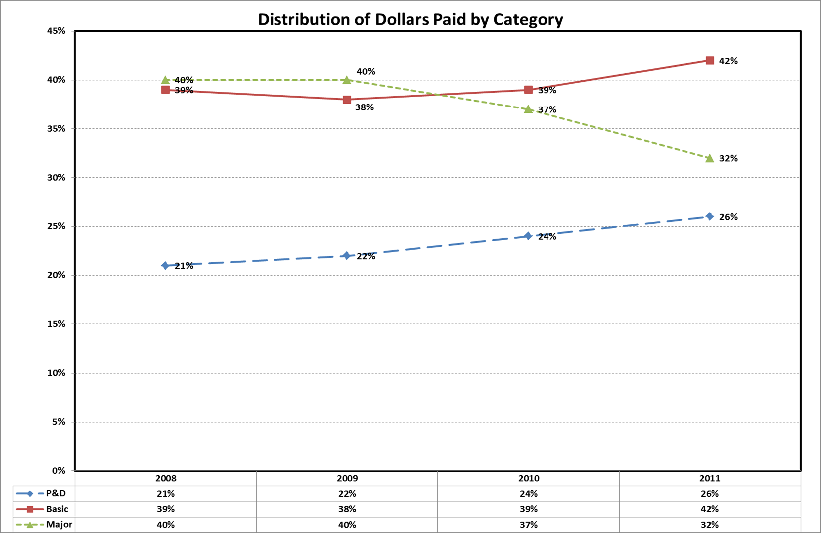
Tracking & Reporting
Result of Disease Management: LIBERTY sees some increases in Costs for Diagnostic,
Preventive and Basic services, and reductions in Costs for Major Services

Slide 23
LIBERTY Results
Outreach Successes (since 2008)
  Annual Dental Visits (HEDIS) up by over 30 percentage points
  Preventive Services up over 25 percentage points
  Dental Treatment services doubled
  Oral Evaluations up over 30 percentage points
  Utilization of Preventive and Treatment services combined up more than doubled.
  Continuity of care measures up over 30 percentage points

Slide 24
Medical-Dental Integration Opportunities
  27M people in US see a Dentist that don’t see a Physician
    Let’s sensitize Dentists to scout for health issues and cross-refer
  108M people in US see a Physician that don’t see a Dentist
    Let’s sensitize Physicians and Health System professionals to scout for oral health issues and cross-refer
  Reduction in Operating Room costs for Early Childhood caries
    Early Childhood caries is preventable and is costing substantial cost and suffering
    Operating Room costs are often borne by the Health Plan – even for dental cases
  Get Health Plans and Dental Plans coordinating their efforts at making a significant impact on these costs and disease entities

Slide 25
Medical-Dental Integration Opportunities
  Significant Dollars are spent by Dental Plans in age 0-8 children for restoration of primary molars (“baby teeth”)
    Early Childhood caries is preventable and is costing substantial cost and suffering
    Let’s get Early Childhood Caries under control with increased education to expectant mothers, women of child-bearing years, and fluoride therapies for young children
  Significant Dollars are spent by Dental Plans in age 7-17 children/teens for restoration of the first and second permanent
    Let’s get first and second molars on children and teens sealed and provide fluoride treatments.
  Use risk assessments for treating risk-based care
  Re-align coverage incentives to drive utilization of Fluoride and Sealants (for children and teens); Perio Maintenance and other perio treatments in adult high-risk individuals

Slide 26

Dental/Medical Collaboration Value Proposition
Dental is an integral part of overall health
Connecting the interrelationships of health to provide the best outcome for members
By promoting good oral health, plan sponsors promote overall health
Health Plan cost savings can be realized
Contact: Dr. Gary Dougan, gdougan@libertydentalplan.com; 888-273-2997 x 470
Bill Henderson, Dave Meadows

